Slide 1
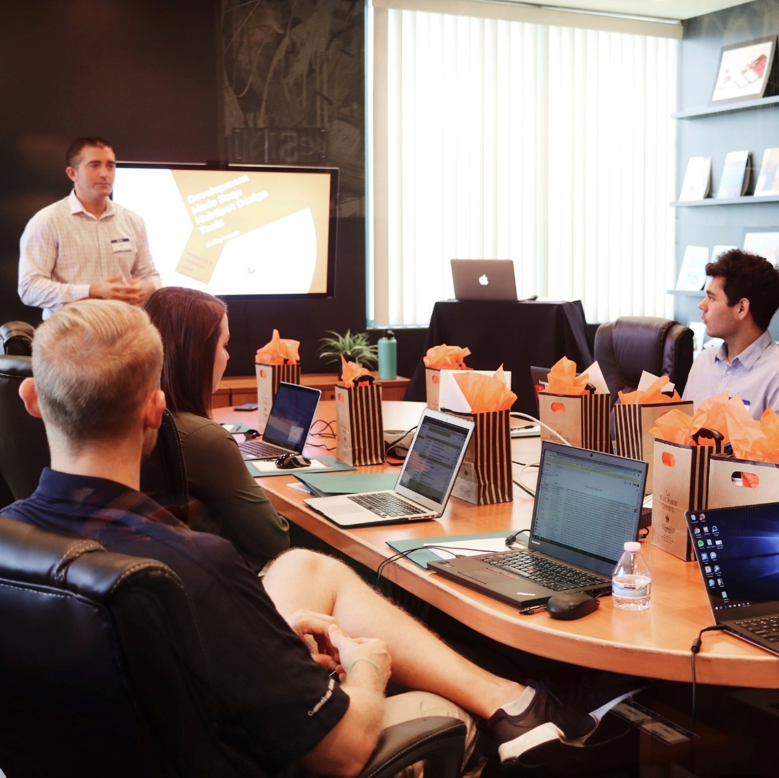
Project Kickoff Meeting
for
<Project Name>

Slide 2

Agenda
Background
Scope
Project Structure
Solution
Implementation Approach
Schedule
Communication Plan
Key Success Factors
Challenges
Action Plans

Slide 3
Project Background
Project Name | <Project Title >
Project Description | <Description of project – can use the contract title or specifically describe high level coverage of the project>
Project Value | USD x,xxx,xxx.xx
Project Duration | <months> Start : mm/dd/yyyy End : mm/dd/yyyy
Project Manager
Project Director
Project Manager (<client>)
Project Director (<client>)
3

Slide 4
Project Objectives
Why we need to integrate to system xxx ?
To have faster information retrieval ….
1
Why do we need to change platform
To have a latest technology….
2
3
Objective 3
Brief description of objective 3
4

Slide 5

Scope Statement
The Project is to supply, deliver, install, configure, commission and maintain the XXX System for XXX Department, Ministry of XXX.
Other scope of work includes the Infrastructure, Change Management and Data Cleansing & Migration.
5

Slide 6
Deliverables
No | Scope of Work | Deliverable(s) | Owner | Remark
1. | System Development | Project Management Application development for XX modules, etc Installation Warranty | Vendor1 Vendor1 Vendor1
2. | Infrastructure | a. Manage Network Connectivity inclusive of 256Kbps Leased Line with DSL backup. b. Test the connectivity from XXX to YYY | Vendor2 Vendor2
3. | Data Management | Data Cleansing Data Migration from System XXX to the new system | Vendor1 Vendor1
4. | Change Management | Training Workshops | Vendor1 Vendor1
6

Slide 7
Key Stakeholders
Objectives, Expectations & Needs
Consultant
Project Team
Suppliers
Ministry A
Public
Client Org
Project
Internal Stakeholders
External Stakeholders
7

Slide 8
Project Structure
Change Control
Board
Project Steering
Committee
Client Project
Director
Project
Director
Vendor1
Project Manager
Client Project
Manager
Project Manager
Development
Team
End Users
PMO
Infrastructure
/ Implementation
Application
Management
Manager
Quality
Assurance
Agency 1
Database
Administrator
Development
Team Lead
Business/
Functional
Team Lead
Agency 2
Agency 3
8

Slide 9
System Development
Loan Module
Online Inquiry
Integration to e-Payment
Customer Information System
To develop, install, commission System XXX
System Maintenance
Audit Trail
Security
9

Slide 10
Technology To Use
Uses xxx technology …..
Provides user interface ……
The technology will allow System XXX to have maximum….
Minimize delay in ….
10

Slide 11
Implementation Approach
Functional
Specification
Technical Design
Application Development
Testing
Commissioning Go Live
Functional Specification
Solution Design Overview
Conceptual Data Model
User Roles
Enterprise Structure Design
System Architecture Document
Database Design Document
Information Architecture Document
RACI Matrix
Interface Control Document (ICD) and Interface Data Description (IDD)
BPM Modeling
Software Development
Conduct
Functional Testing
System testing
Integration Testing
Security Testing
Exception Testing
Business Scenario Testing
Usability testing
Performance Testing
Connectivity Testing
Backup and restore testing
Provide Training
Support and Warranty
Provide As-Built Design Documentation
Build 1
Build 2
Build 3
Build… n
SIT
Formal
Testing
Verification
UAT
Change Management
Training
11

Slide 12
Project Milestone
Milestone
Milestone
Add Short Description
Add Short Description
Milestone
Milestone
Milestone
Add Short Description
Add Short Description
Add Short Description
Q2
Q4
Q1
Q3
Q5
12

Slide 13
Project Schedule
Tasks | Year 1 | Year 2
 | J | F | M | A | M | J | J | A | S | O | N | D | J | F | M | A | M | J | J | A | S | O | N | D
Task 1
Task 2
Sub-task A
Sub-task B
Sub-task C
Task 3
Task 4
Review
Revisions
Delivery
13

Slide 14
Payment Schedule
No | Description | % / Mode | Amount to bill
1
2
3
14

Slide 15
Communication Plan
Type of Communication | Internal | External ( with Client )
Email/Letter | Circulation of Internal SOP Schedule for Meeting Internal Activity Coordination | Request for Meeting Activity Schedule
Meeting | Weekly Team Meeting Weekly Leaders Meeting Monthly Project Meeting Monthly PSC Meeting | Progress Meeting Technical meeting Monthly PSC Meeting Monthly CCB Meeting
Reports | Monthly Progress Report PSC Slides | Project Status Report Monthly Risk Assessment Report
15

Slide 16

Key Success Factors
Ensuring senior management support
Clearly defined project scope
Official nomination on User Champions
User’s involvement
Realistic deadlines
Managing project risk efficiently
Effectively managing change associated with the project
16

Slide 17
Challenges
Project Challenges
Lack of Stakeholder Engagement
Scope Changes
Uncertain dependencies
Geographically dispersed project teams
Shifting Organizational Priorities
17

Slide 18
Preliminary Risks
Deliverables dependencies on third party
The project timeframe is short and tight
Business process integrity – certain branches may have different requirement.
18

Slide 19
Mitigation Plan
Risk Factors | Probability | Mitigation Ideas
Deliverables dependencies on third party | Medium | Communication Plan Master timeline
The project timeframe is short and tight | Medium | Close monitoring
Business process integrity – certain branches may have different requirement | Medium | Detailed specifications Early prototype/review of functionality Add more time to the project schedule.
19

Slide 20

Action Plans
Complete and baseline project plan
Compile contact details
Create email group
Set up configuration and development environments
Perform preliminary fit/gap analysis
Document current business processes
Plan workshops and trainings
20

Slide 21
Q & A
Q&A
Thank You
21

